Slide 1
DATA SCIENCE
NAME : DAMODARA LEELAPRASAD
ROLL-NO : 246C5A5402
BRANCH : ARTIFICIAL INTELLIGENCE & DATA SCIENCE

Slide 2
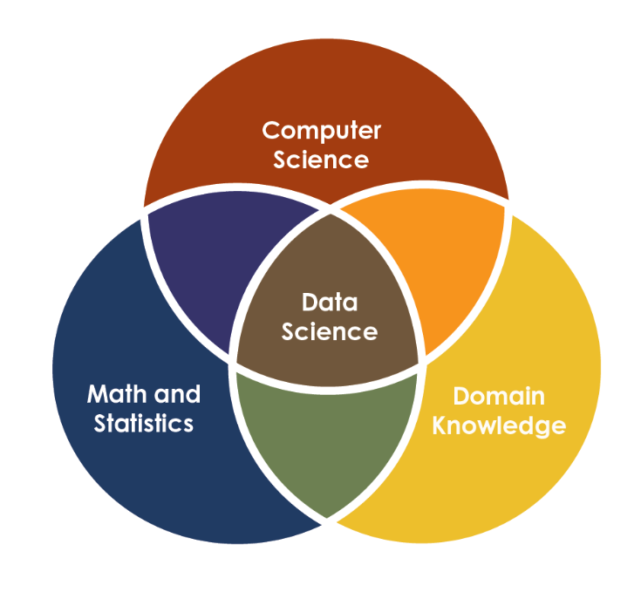
What is data science
Data science is an interdisciplinary field that uses scientific methods, processes, algorithms and systems to extract knowledge and insights from many structural and unstructured data

Slide 3
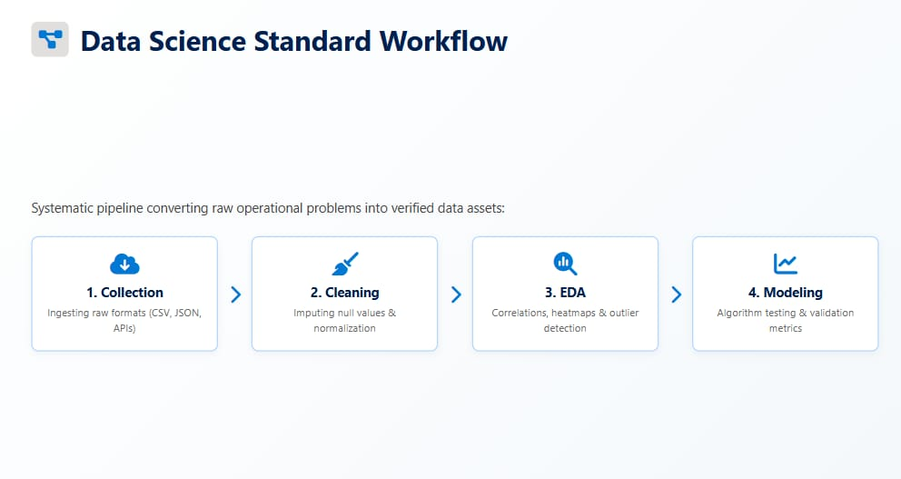
DATA SCIENCE WORKFLOW

Slide 4
Technical stack in data science
Python
SQL
NUMPY,PANDAS
MATPLOTLIB
MACHINE LEARNING(SCIKIT-LEARN)
DEEP LEARNING(PYTORCH,TENSORFLOW)
FAST API

Slide 5
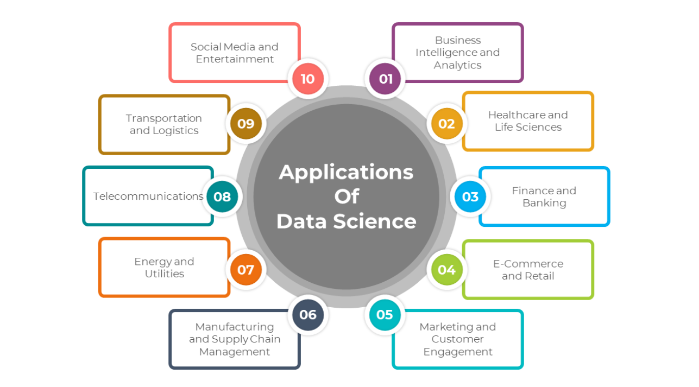
REAL WORLD APPLICATIONS

Slide 6
HEALTH CARE
Disease Prediction System
A machine-learning powered symptom checker that predicts likely diseases and recommends precautions, medication, diet, and workout — delivered through a Flask web app with optional voice input.
Symptoms → ML Model → Recommendations
41
132
5
Diseases
covered
Symptoms
recognized
Outputs per
prediction

Slide 7
Input & Output
What the system takes in, and what it hands back to the patient
1
INPUT
2
OUTPUT
Symptom text
✓
Predicted disease name (one of 41 classes)
Free-text symptoms typed into the web form, comma-separated (e.g. "itching, high fever, headache").
✓
Plain-language description of the condition
Voice command
Four recommended precautions to follow
Spoken symptoms captured via microphone and converted to text using Google's speech-recognition API.
✓
✓
Suggested medications, each linked to a drugs.com search
Fuzzy correction
Misspelled or loosely-worded symptoms are auto-matched to the closest known symptom name.
✓
Recommended diet plan
✓
Suggested workout / activity guidance

Slide 8
Technologies Used
The stack behind the model, the app, and the voice interface
Machine Learning
Web Application
Voice Interface
Python
Flask (routing & backend)
SpeechRecognition library
scikit-learn (SVC classifier)
HTML / Jinja2 templates
Google Speech-to-Text API
LabelEncoder
difflib (fuzzy symptom matching)
Microphone audio capture
Pandas & NumPy
CSV-based knowledge base
Pickle (model serialization)
Pipeline: CSV datasets → Label encoding → SVC training → Pickled model → Flask API → Web / Voice UI

Slide 9
THANKING YOU

